Slide 1
Task 3
Refinement of cell annotations using Machine learning models

Slide 2
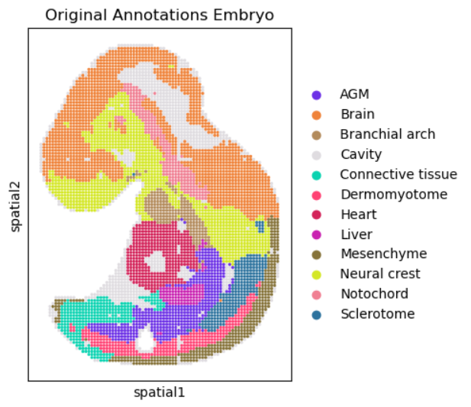
Embryo dataset
5913 cells
25568 features
Genes and spatial coordinates

Slide 3
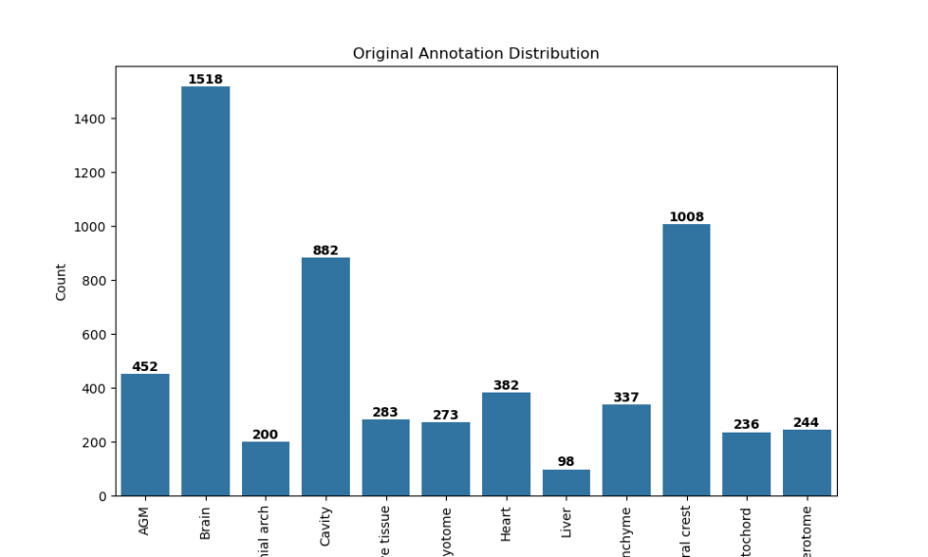
Annotations – Original distribution

Slide 4
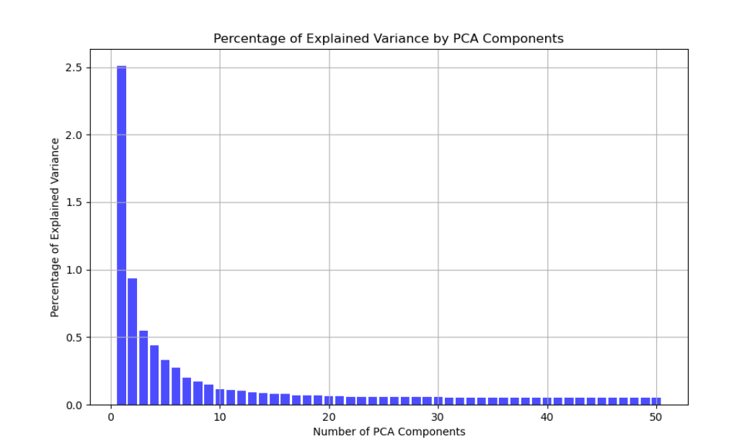
Principal component analysis
Large amount of features
10 PCA components

Slide 5
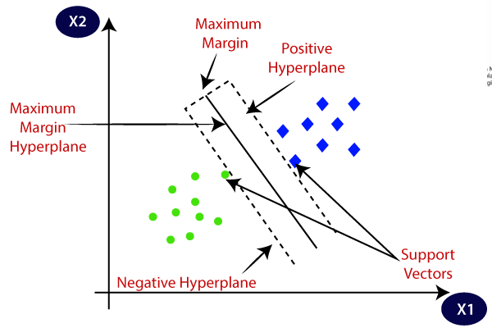
Supporting Vector Machine with K-fold Cross Validation
Different values for K and L

Slide 6
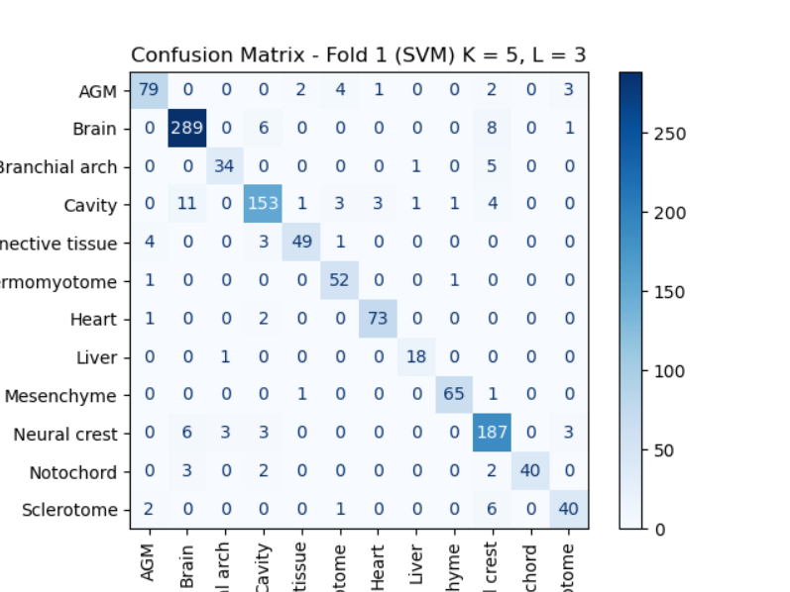
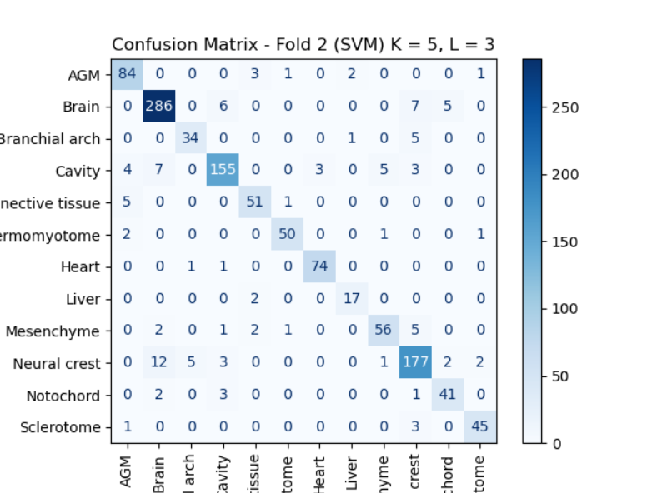
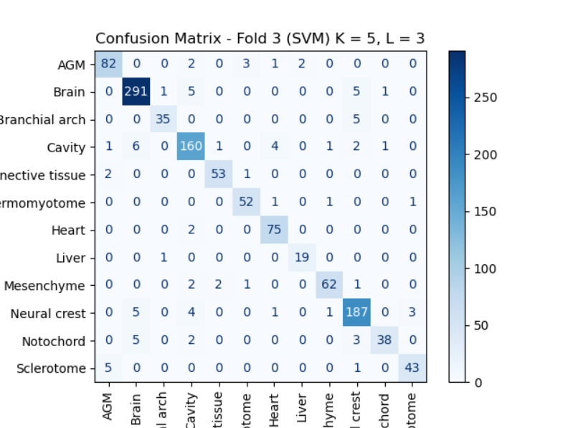
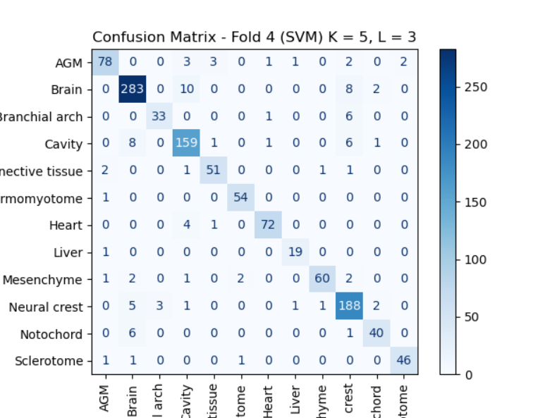
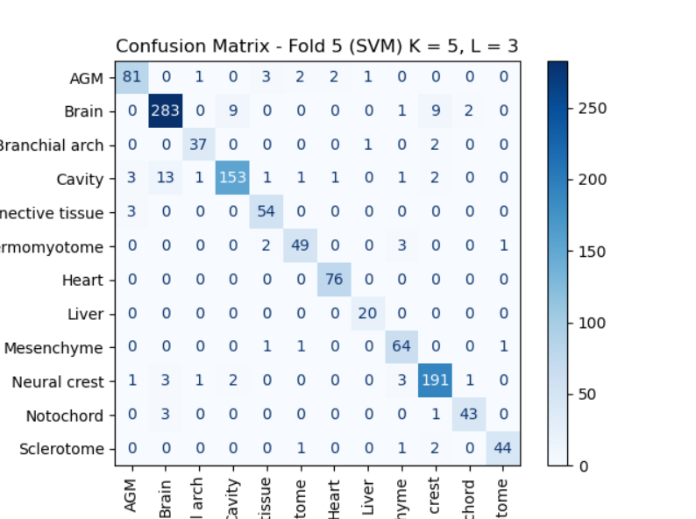
Confusion matrix

Slide 7
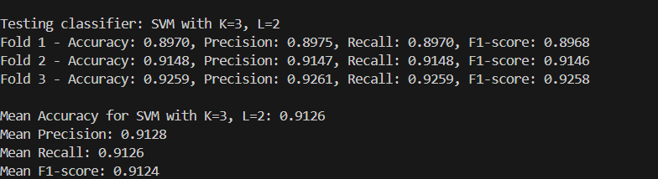

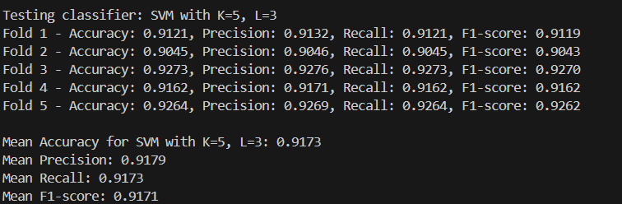

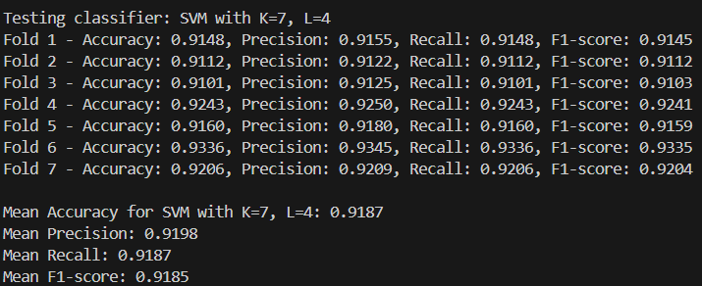

Model evaluation

Slide 8
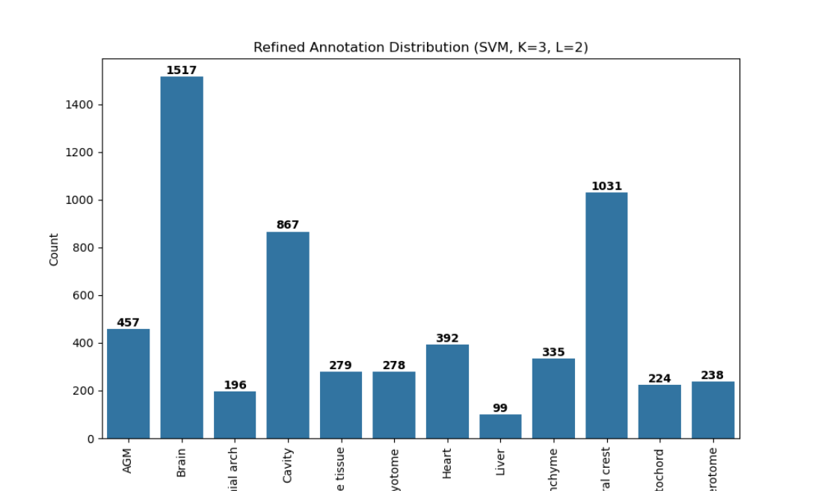


Annotations after refinement - distribution

Slide 9
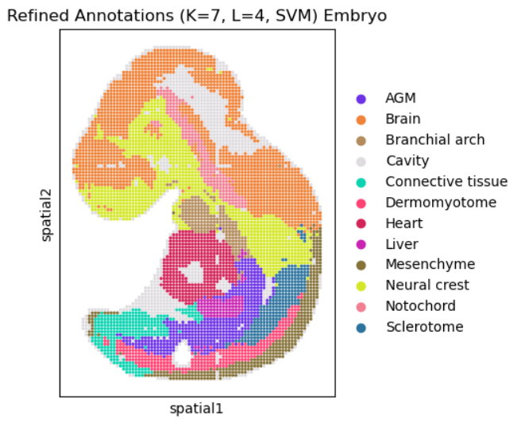


Annotations after refinement – spatial plots

Slide 10
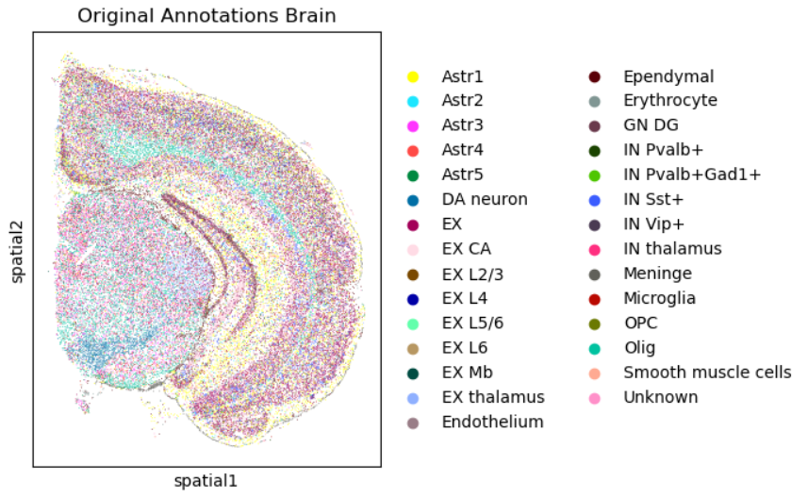
Brain dataset
50140 cells
25879 features
Genes and spatial coordinates

Slide 11
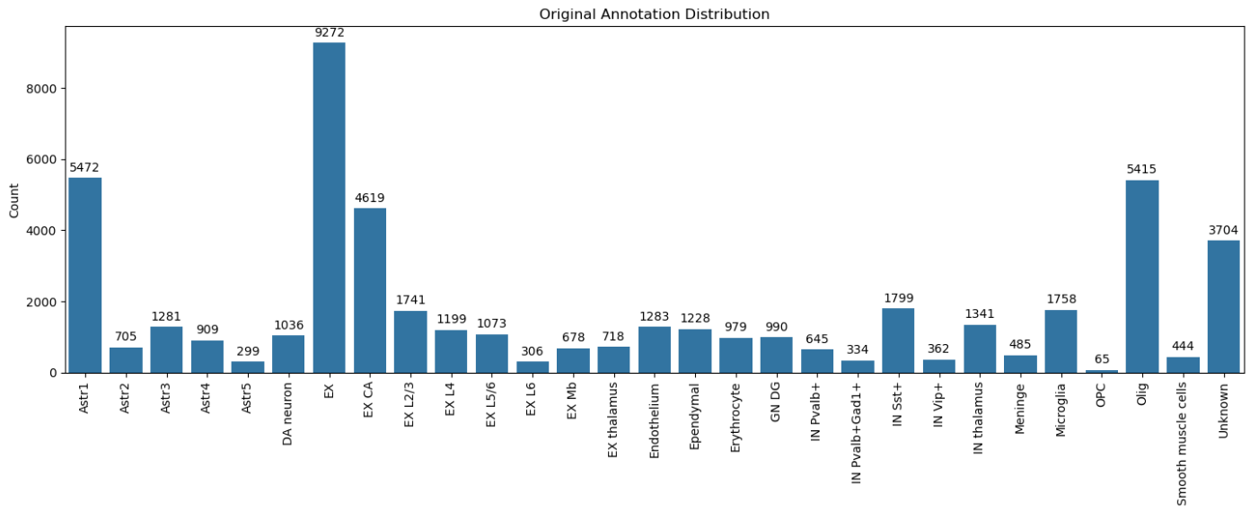
Annotations and features

Slide 12
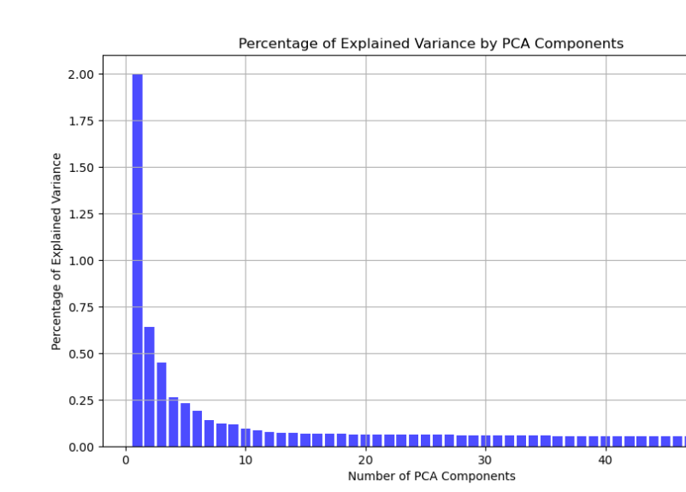
Principal component analysis
Large amount of features
8 PCA components

Slide 13
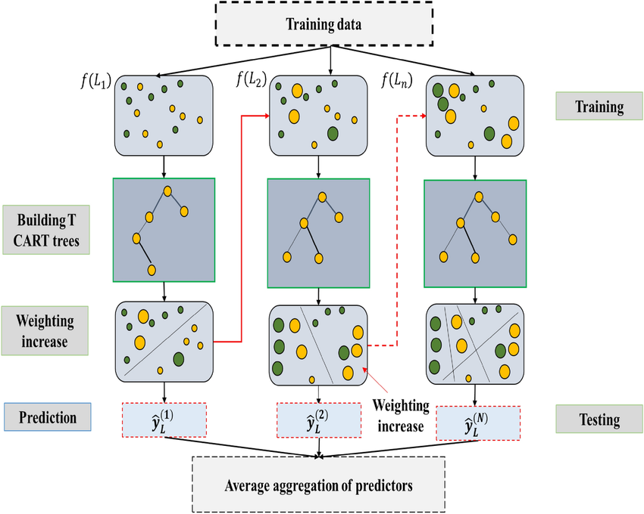
XGBoost with K-fold Cross Validation

Slide 14
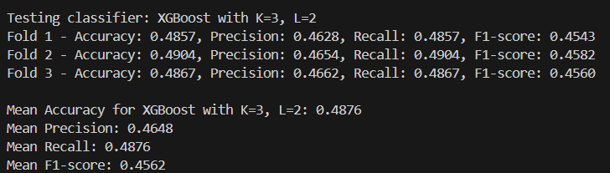

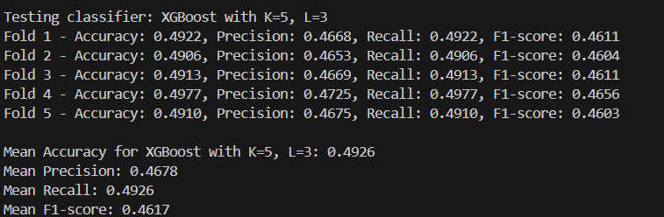

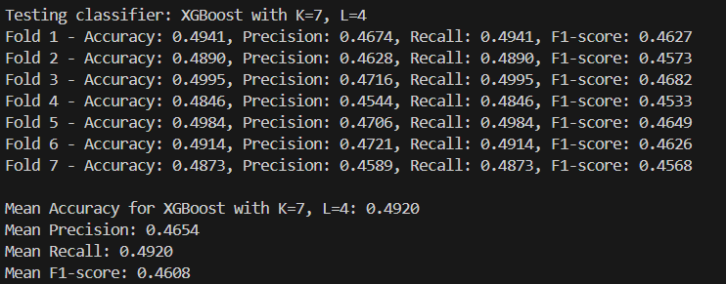

Model evaluation

Slide 15


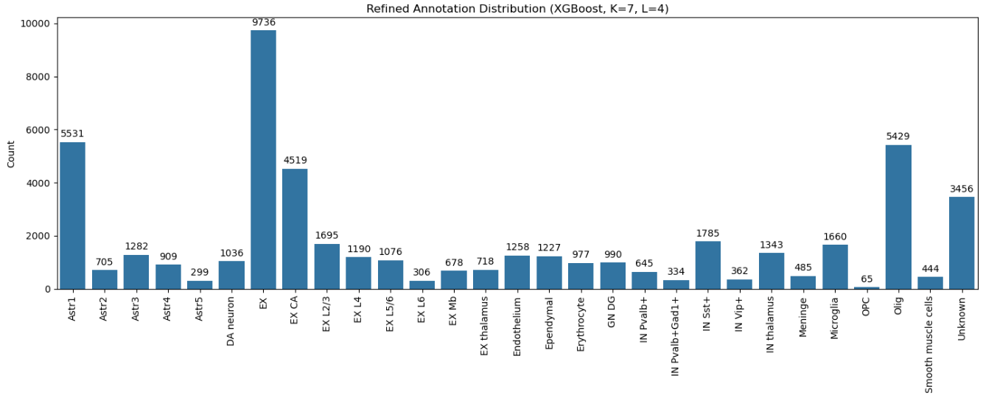
Annotations after refinement – Distribution

Slide 16
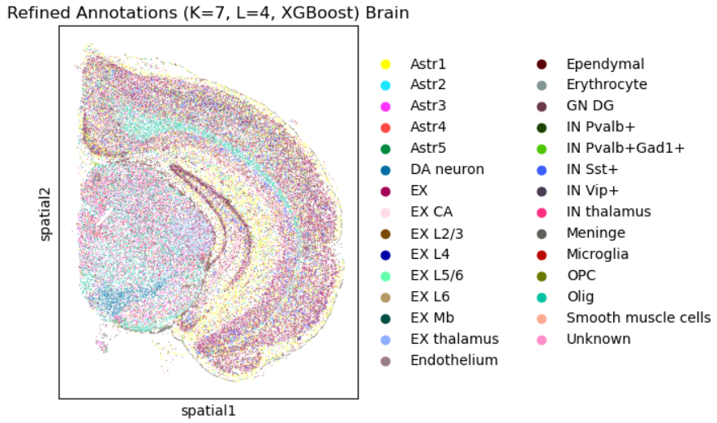


Annotations after refinement – Spatial plots

Slide 17
THE END

